Slide 1

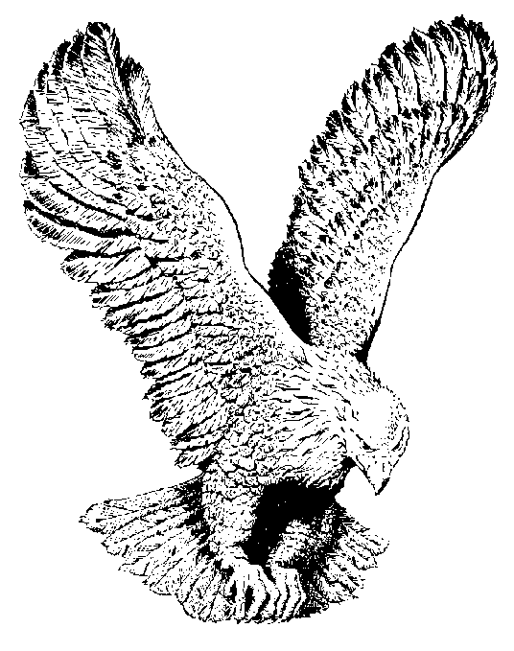
MY JESUS I LOVE THEE
My Jesus, I love thee, I know thou art mine,
For thee all the follies of sin I resign;
My gracious Redeemer, my Saviour art Thou;
If ever I love Thee, my Jesus, tis now.

Slide 2
I love thee because Thou hath first loved me,
And purchased my pardon on calvary’s tree;
I love Thee for wearing the thorns on thy brow,
If ever I love Thee, my Jesus tis now.

Slide 3
In mansions of glory and endless delight,
I’ll ever adore Thee in heaven so bright;
I’ll sing with the glittering crown on my brow;
If ever I loved Thee my Jesus tis now.

